Slide 1
Hypothesis Testing
Programming and Data Analysis for Modern Neuroscience
Spring 2020

Slide 2
The null hypothesis and p-values

Slide 3
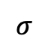
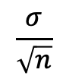
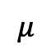
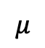
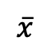
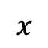
Population A
(we don’t usually know
this distribution)
$$σ$$
$$μ$$
$$x$$
Compute statistic for sample
e.g. mean
$$\frac{σ}{\sqrt{n}}$$
Random sample of size n
$$μ$$
$$\overline{x}$$
sample mean
(so far, this is our best guess for the population mean)

Slide 4
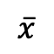
Population A
(we don’t usually know
this distribution)
$$σ$$
$$μ$$
$$x$$
Repeat for multiple samples, all of size n
Compute statistic for each sample
e.g. mean
$$\frac{σ}{\sqrt{n}}$$
Random sample of size n
$$μ$$
$$\overline{x}$$
sample means

Slide 5
Population A
(we don’t usually know
this distribution)
$$σ$$
$$μ$$
$$x$$
Repeat for multiple samples, all of size n
By Central Limit Theorem, for large enough n, distribution of sample means will approach a normal distribution even if the population distribution is not normal.
Compute statistic for sample
e.g. mean
$$\frac{σ}{\sqrt{n}}$$
Random sample of size n
$$μ$$
$$\overline{x}$$
sample means

Slide 6
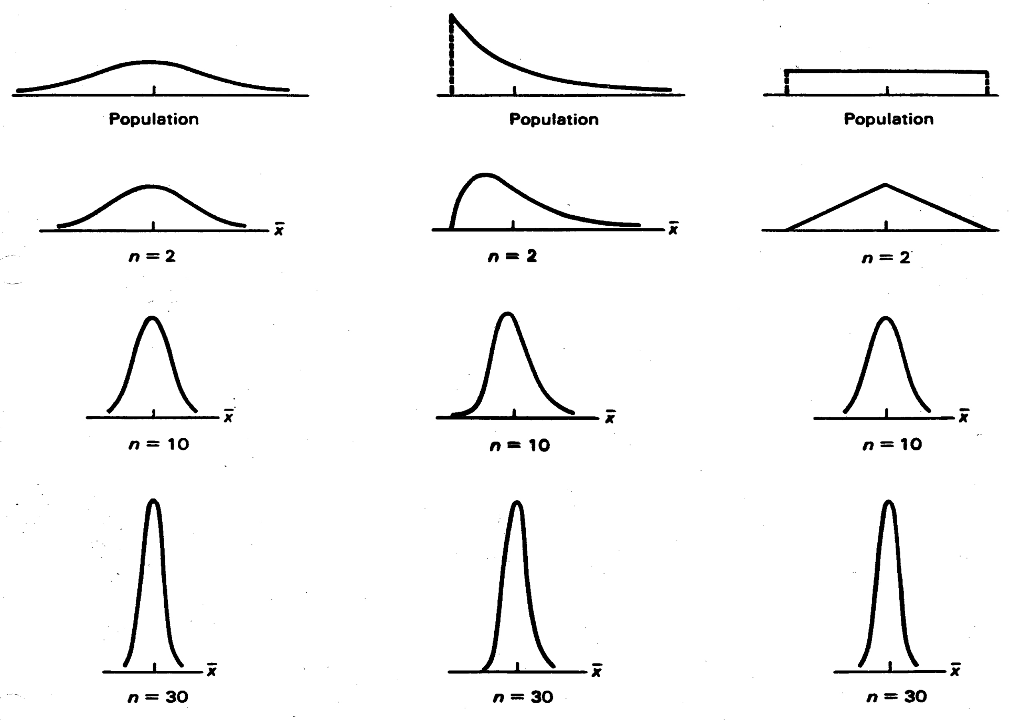
Central Limit Theorem

Slide 7
Distribution of scores in a recall task for subjects given a placebo
$$σ$$
$$μ$$
$$x$$
Repeat for multiple samples, all of size n
Ok, so assume we do this for a bunch of samples with large n and we get a pretty good estimate of the mean and standard deviation of recall task scores for subjects given a placebo.
Compute statistic for sample
e.g. mean
$$\frac{σ}{\sqrt{n}}$$
Random sample of size n
$$μ$$
$$\overline{x}$$
sample means

Slide 8
Distribution of scores in a recall task for subjects given a placebo
Distribution of scores in a recall task for subjects given an experimental drug
$$σ$$
$$μ$$
$$x$$
Compute statistic for sample
e.g. mean
$$\frac{σ}{\sqrt{n}}$$
Compute statistic for sample
e.g. mean
Random sample of size n
Random sample of size n
$$μ$$
$$\overline{x}$$
Does the drug affect mean recall?

Slide 9
Distribution of scores in a recall task for subjects given a placebo
Distribution of scores in a recall task for subjects given an experimental drug
$$σ$$
$$μ$$
$$x$$
Compute statistic for sample
e.g. mean
$$\frac{σ}{\sqrt{n}}$$
Compute statistic for sample
e.g. mean
Random sample of size n
Random sample of size n
$$μ$$
$$\overline{x}$$
No

Slide 10
Distribution of scores in a recall task for subjects given a placebo
Distribution of scores in a recall task for subjects given an experimental drug
$$σ$$
$$μ$$
$$x$$
Compute statistic for sample
e.g. mean
$$\frac{σ}{\sqrt{n}}$$
Compute statistic for sample
e.g. mean
Random sample of size n
Random sample of size n
$$μ$$
$$\overline{x}$$
Does the drug affect mean recall?

Slide 11
Distribution of scores in a recall task for subjects given a placebo
Distribution of scores in a recall task for subjects given an experimental drug
$$σ$$
$$μ$$
$$x$$
Compute statistic for sample
e.g. mean
$$\frac{σ}{\sqrt{n}}$$
Compute statistic for sample
e.g. mean
Random sample of size n
Random sample of size n
$$μ$$
$$\overline{x}$$
Yes

Slide 12
Distribution of scores in a recall task for subjects given a placebo
Distribution of scores in a recall task for subjects given an experimental drug
$$σ$$
$$μ$$
$$x$$
Compute statistic for sample
e.g. mean
$$\frac{σ}{\sqrt{n}}$$
Compute statistic for sample
e.g. mean
Random sample of size n
Random sample of size n
$$μ$$
$$\overline{x}$$
Does the drug affect mean recall?

Slide 13
Distribution of scores in a recall task for subjects given a placebo
Distribution of scores in a recall task for subjects given an experimental drug
$$σ$$
$$μ$$
$$x$$
Compute statistic for sample
e.g. mean
$$\frac{σ}{\sqrt{n}}$$
Compute statistic for sample
e.g. mean
Random sample of size n
Random sample of size n
$$μ$$
$$\overline{x}$$
?

Slide 14
Distribution of scores in a recall task for subjects given a placebo
Distribution of scores in a recall task for subjects given an experimental drug
$$σ$$
Null Hypothesis H₀: Drug has no effect
Alternative Hypothesis H_{a}: Drug has an effect
$$μ$$
$$x$$
Compute statistic for sample
e.g. mean
$$\frac{σ}{\sqrt{n}}$$
Compute statistic for sample
e.g. mean
Random sample of size n
Random sample of size n
$$μ$$
$$\overline{x}$$
?

Slide 17
Typically,
α = 0.05

Slide 19
Distribution of scores in a recall task for subjects given a placebo
Distribution of scores in a recall task for subjects given an experimental drug
$$σ$$
Null Hypothesis H₀: Drug has no effect
Alternative Hypothesis H_{a}: Drug has an effect
$$μ$$
$$x$$
H_{a}
H₀
H_{a}
Compute statistic for sample
e.g. mean
$$\frac{σ}{\sqrt{n}}$$
Compute statistic for sample
e.g. mean
v
Random sample of size n
Random sample of size n
$$μ$$
$$\overline{x}$$
Do NOT reject H₀ → Infer drug has no effect
p-value > 0.05 / 2

Slide 20
!!! p-value calculations assume that the null hypothesis is correct.
Thus, from the p-value’s point of view, the null hypothesis is 100% true.
p-values assume that the null hypothesis is true, and that the observed sample effect is caused by random sample error.
p-values tell you how consistent your sample data are with a null hypothesis that is true.
However, when your data are very inconsistent with the null hypothesis, p-values can’t determine which of the following two possibilities is more probable:
The null hypothesis is true, but your sample is unusual due to random sample error.
The null hypothesis is false.
!!! p-values ARE NOT the probability of any specific alternative hypothesis being true.

Slide 21
Power and sample size

Slide 22
e.g. control distribution
e.g. test distribution
H₀
H_{a}

Slide 23
Type II Error
H₀ was false, but we didn’t reject it
Type I Error
H₀ was true, but we rejected it
H₀
H_{a}

Slide 24
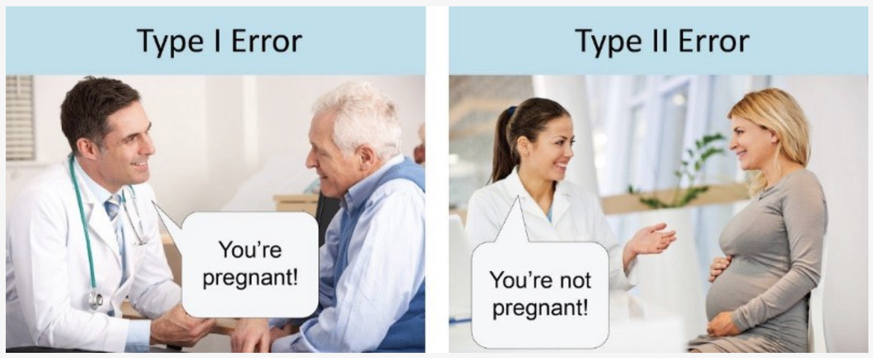
Type II Error
H₀ was false, but we didn’t reject it
Type I Error
H₀ was true, but we rejected it
H₀
H_{a}

Slide 25
Type II Error
H₀ was false, but we didn’t reject it
1 – β = Power
Probability that we actually reject H₀ when it is false
Type I Error
H₀ was true, but we rejected it
H₀
H_{a}

Slide 26
Power = 0.5
!!! Only 50% chance of detecting a real difference.
p = 0.049

Slide 27
Small samples from populations A & B:
Low power
Large samples from same populations A & B:
High power

Slide 28
Small samples from populations A & B:
Low power
You can almost always get a significant p-value if you use a huge sample size. However, the effect size is likely to be tiny, and thus probably meaningless.
Large samples from same populations A & B:
High power

Slide 29
t-Test for sample means

Slide 30
data set A
data set B
x
x
x
x
x
x
x
x
x
x
x
x
x
x
x
x
x
x
x
x
x
x
x
x
x
x
x
x
x
x
x
x
x
x
x
x
x
x
x
x
x
x
x
x

Slide 31
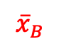
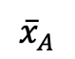
data set A
data set B
x
x
x
x
x
x
x
x
x
x
x
x
x
x
x
x
x
x
x
x
x
x
x
x
Compare means of two data sets
x
x
x
x
x
x
x
x
x
x
x
x
x
x
x
x
x
x
x
x
$${\overline{x}}_{A}$$
$${\overline{x}}_{B}$$
mean

Slide 32
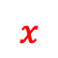
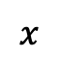
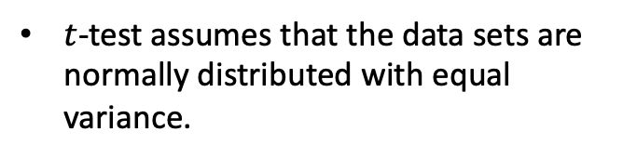
data set A
data set B
x
x
x
x
x
x
x
x
x
x
x
x
x
x
x
x
x
x
x
x
x
x
x
x
Compare means of two normally distributed data sets
x
x
x
x
x
x
x
x
x
x
x
x
x
x
x
x
x
x
x
x
$$x$$
$$x$$
$t$-test assumes that the data sets are normally distributed with equal variance.
$${\overline{x}}_{A}$$
$${\overline{x}}_{B}$$
mean

Slide 33
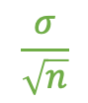

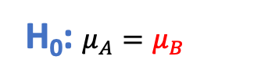
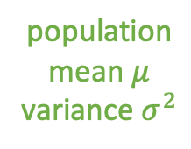
data set A
data set B
population
mean $μ$
variance $σ^{2}$
x
x
x
x
x
x
x
x
x
x
x
x
x
x
x
x
x
x
x
x
x
x
x
x
x
x
x
x
x
x
x
x
x
H₀: data sets A and B came from the same population, differences due entirely to random variation
x
x
x
x
x
x
x
x
x
x
x
H₀: $μ_{A}=μ_{B}$
$$\frac{σ}{\sqrt{n}}$$
$${\overline{x}}_{A}$$
$$μ$$
$${\overline{x}}_{B}$$
mean

Slide 34
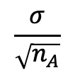
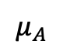
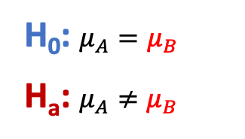
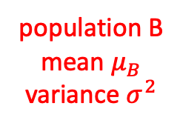
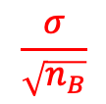
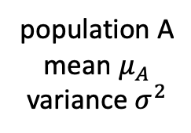
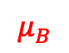
data set A
data set B
population A
mean $μ_{A}$
variance $σ^{2}$
population B
mean $μ_{B}$
variance $σ^{2}$
x
x
x
x
x
H_{a}: data sets A and B did NOT come from the same population, differences unlikely to be due entirely to random variation
x
x
x
x
x
x
x
x
x
x
x
x
x
x
x
x
x
x
x
x
x
x
x
x
x
x
x
x
x
x
x
x
x
x
x
x
x
x
x
H₀: $μ_{A}=μ_{B}$
H_{a}: $μ_{A}≠μ_{B}$
$$\frac{σ}{\sqrt{n_{A}}}$$
$$\frac{σ}{\sqrt{n_{B}}}$$
$${\overline{x}}_{A}$$
$${\overline{x}}_{B}$$
mean
$$μ_{A}$$
$$μ_{B}$$

Slide 35
data set A
data set B
x
x
x
x
x
x
x
x
x
x
x
x
x
x
x
x
x
x
x
x
x
x
x
x
Compare means of two normally distributed data sets
x
x
x
x
x
x
x
x
x
x
x
x
x
x
x
x
x
x
x
x
Formulate H₀ and H_{a}.
H₀: $μ_{A}=μ_{B}$
H_{a}: $μ_{A}≠μ_{B}$
$${\overline{x}}_{A}$$
$${\overline{x}}_{B}$$
mean

Slide 36
data set A
data set B
x
x
x
x
x
x
x
x
x
x
x
x
x
x
x
x
x
x
x
x
x
x
x
x
Compare means of two normally distributed data sets
x
x
x
x
x
x
x
x
x
x
x
x
x
x
x
x
x
x
x
x
Formulate H₀ and H_{a}.
Assume H₀ is true.
H₀: $μ_{A}=μ_{B}$
H_{a}: $μ_{A}≠μ_{B}$
$${\overline{x}}_{A}$$
$${\overline{x}}_{B}$$
mean

Slide 37
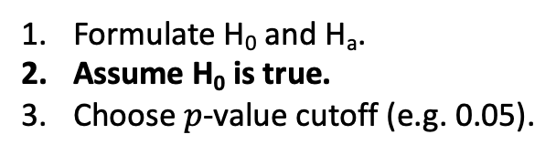
data set A
data set B
x
x
x
x
x
x
x
x
x
x
x
x
x
x
x
x
x
x
x
x
x
x
x
x
Compare means of two normally distributed data sets
x
x
x
x
x
x
x
x
x
x
x
x
x
x
x
x
x
x
x
x
Formulate H₀ and H_{a}.
Assume H₀ is true.
Choose $p$-value cutoff (e.g. 0.05).
H₀: $μ_{A}=μ_{B}$
H_{a}: $μ_{A}≠μ_{B}$
$${\overline{x}}_{A}$$
$${\overline{x}}_{B}$$
mean

Slide 38
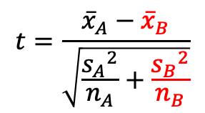
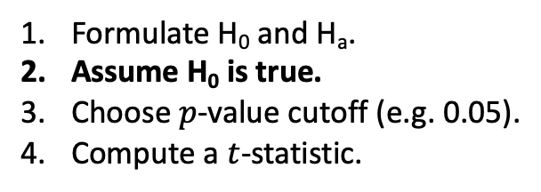
data set A
data set B
x
x
x
x
x
x
x
x
x
x
x
x
x
x
x
x
x
x
x
x
x
x
x
x
Compare means of two normally distributed data sets
x
x
x
x
x
x
x
x
x
x
x
x
x
x
x
x
x
x
x
x
$$t=\frac{{\overline{x}}_{A}−{\overline{x}}_{B}}{\sqrt{\frac{{s_{A}}^{2}}{n_{A}}+\frac{{s_{B}}^{2}}{n_{B}}}}$$
Formulate H₀ and H_{a}.
Assume H₀ is true.
Choose $p$-value cutoff (e.g. 0.05).
Compute a $t$-statistic.
(independent samples A and B)
H₀: $μ_{A}=μ_{B}$
H_{a}: $μ_{A}≠μ_{B}$
$${\overline{x}}_{A}$$
$${\overline{x}}_{B}$$
mean

Slide 39
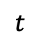
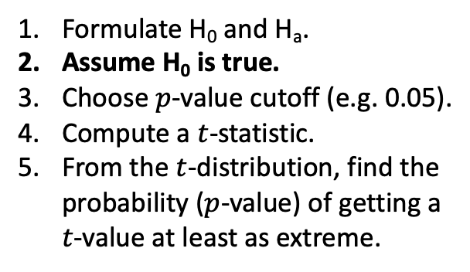
data set A
data set B
x
x
x
x
x
x
x
x
x
x
x
x
x
x
x
x
x
x
x
x
x
x
x
x
Compare means of two normally distributed data sets
x
x
x
x
x
x
x
x
x
x
x
x
x
x
x
x
x
x
x
x
$$t=\frac{{\overline{x}}_{A}−{\overline{x}}_{B}}{\sqrt{\frac{{s_{A}}^{2}}{n_{A}}+\frac{{s_{B}}^{2}}{n_{B}}}}$$
Formulate H₀ and H_{a}.
Assume H₀ is true.
Choose $p$-value cutoff (e.g. 0.05).
Compute a $t$-statistic.
From the $t$-distribution, find the probability ($p$-value) of getting a $t$-value at least as extreme.
H₀: $μ_{A}=μ_{B}$
H_{a}: $μ_{A}≠μ_{B}$
0
$$t$$

Slide 40
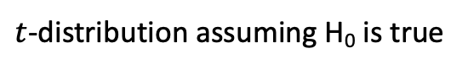
data set A
data set B
x
x
x
x
x
x
x
x
x
x
x
x
x
x
x
x
x
x
x
x
x
x
x
x
Compare means of two normally distributed data sets
x
x
x
x
x
x
x
x
x
x
x
x
x
x
x
x
x
x
x
x
$$t=\frac{{\overline{x}}_{A}−{\overline{x}}_{B}}{\sqrt{\frac{{s_{A}}^{2}}{n_{A}}+\frac{{s_{B}}^{2}}{n_{B}}}}$$
Formulate H₀ and H_{a}.
Assume H₀ is true.
Choose $p$-value cutoff (e.g. 0.05).
Compute a $t$-statistic.
From the $t$-distribution, find the probability ($p$-value) of getting a $t$-value at least as extreme.
$t$-distribution assuming H₀ is true
H₀: $μ_{A}=μ_{B}$
H_{a}: $μ_{A}≠μ_{B}$
0
$$t$$

Slide 41
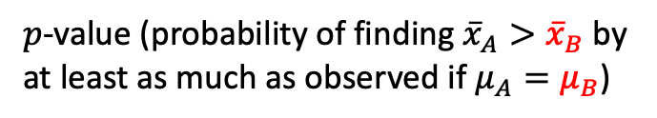
data set A
data set B
x
x
x
x
x
x
x
x
x
x
x
x
x
x
x
x
x
x
x
x
x
x
x
x
Compare means of two normally distributed data sets
x
x
x
x
x
x
x
x
x
x
x
x
x
x
x
x
x
x
x
x
$$t=\frac{{\overline{x}}_{A}−{\overline{x}}_{B}}{\sqrt{\frac{{s_{A}}^{2}}{n_{A}}+\frac{{s_{B}}^{2}}{n_{B}}}}$$
Formulate H₀ and H_{a}.
Assume H₀ is true.
Choose $p$-value cutoff (e.g. 0.05).
Compute a $t$-statistic.
From the $t$-distribution, find the probability ($p$-value) of getting a $t$-value at least as extreme.
$t$-distribution assuming H₀ is true
H₀: $μ_{A}=μ_{B}$
H_{a}: $μ_{A}≠μ_{B}$
$p$-value (probability of finding ${\overline{x}}_{A}>{\overline{x}}_{B}$ by at least as much as observed if $μ_{A}=μ_{B}$)
0
$$t$$

Slide 42
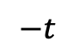
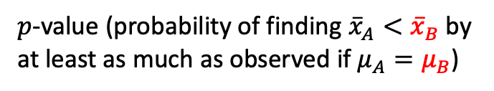
data set A
data set B
x
x
x
x
x
x
x
x
x
x
x
x
x
x
x
x
x
x
x
x
x
x
x
x
Compare means of two normally distributed data sets
x
x
x
x
x
x
x
x
x
x
x
x
x
x
x
x
x
x
x
x
$$t=\frac{{\overline{x}}_{A}−{\overline{x}}_{B}}{\sqrt{\frac{{s_{A}}^{2}}{n_{A}}+\frac{{s_{B}}^{2}}{n_{B}}}}$$
Formulate H₀ and H_{a}.
Assume H₀ is true.
Choose $p$-value cutoff (e.g. 0.05).
Compute a $t$-statistic.
From the $t$-distribution, find the probability ($p$-value) of getting a $t$-value at least as extreme.
$t$-distribution assuming H₀ is true
H₀: $μ_{A}=μ_{B}$
H_{a}: $μ_{A}≠μ_{B}$
$p$-value (probability of finding ${\overline{x}}_{A}>{\overline{x}}_{B}$ by at least as much as observed if $μ_{A}=μ_{B}$)
$$−t$$
0
$$t$$
$p$-value (probability of finding ${\overline{x}}_{A}<{\overline{x}}_{B}$ by at least as much as observed if $μ_{A}=μ_{B}$)

Slide 43
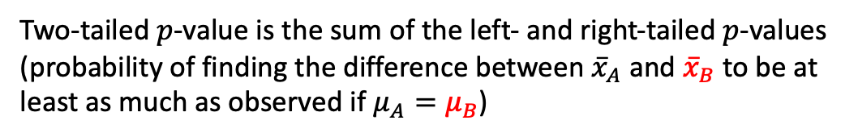
data set A
data set B
x
x
x
x
x
x
x
x
x
x
x
x
x
x
x
x
x
x
x
x
x
x
x
x
Compare means of two normally distributed data sets
x
x
x
x
x
x
x
x
x
x
x
x
x
x
x
x
x
x
x
x
$$t=\frac{{\overline{x}}_{A}−{\overline{x}}_{B}}{\sqrt{\frac{{s_{A}}^{2}}{n_{A}}+\frac{{s_{B}}^{2}}{n_{B}}}}$$
Formulate H₀ and H_{a}.
Assume H₀ is true.
Choose $p$-value cutoff (e.g. 0.05).
Compute a $t$-statistic.
From the $t$-distribution, find the probability ($p$-value) of getting a $t$-value at least as extreme.
$t$-distribution assuming H₀ is true
H₀: $μ_{A}=μ_{B}$
H_{a}: $μ_{A}≠μ_{B}$
$p$-value (probability of finding ${\overline{x}}_{A}>{\overline{x}}_{B}$ by at least as much as observed if $μ_{A}=μ_{B}$)
$$−t$$
0
$$t$$
$p$-value (probability of finding ${\overline{x}}_{A}<{\overline{x}}_{B}$ by at least as much as observed if $μ_{A}=μ_{B}$)
Two-tailed $p$-value is the sum of the left- and right-tailed $p$-values (probability of finding the difference between ${\overline{x}}_{A}$ and ${\overline{x}}_{B}$ to be at least as much as observed if $μ_{A}=μ_{B}$)

Slide 44
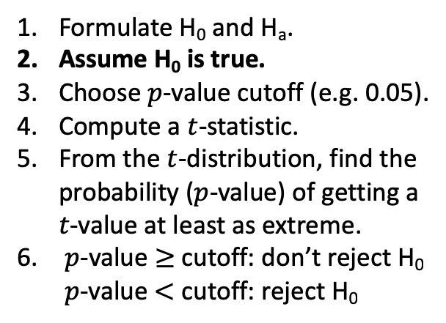
data set A
data set B
x
x
x
x
x
x
x
x
x
x
x
x
x
x
x
x
x
x
x
x
x
x
x
x
Compare means of two normally distributed data sets
x
x
x
x
x
x
x
x
x
x
x
x
x
x
x
x
x
x
x
x
$$t=\frac{{\overline{x}}_{A}−{\overline{x}}_{B}}{\sqrt{\frac{{s_{A}}^{2}}{n_{A}}+\frac{{s_{B}}^{2}}{n_{B}}}}$$
Formulate H₀ and H_{a}.
Assume H₀ is true.
Choose $p$-value cutoff (e.g. 0.05).
Compute a $t$-statistic.
From the $t$-distribution, find the probability ($p$-value) of getting a $t$-value at least as extreme.
$p$-value $≥$ cutoff: don’t reject H₀ $p$-value $<$ cutoff: reject H₀
$t$-distribution assuming H₀ is true
H₀: $μ_{A}=μ_{B}$
H_{a}: $μ_{A}≠μ_{B}$
$p$-value (probability of finding ${\overline{x}}_{A}>{\overline{x}}_{B}$ by at least as much as observed if $μ_{A}=μ_{B}$)
$$−t$$
0
$$t$$
$p$-value (probability of finding ${\overline{x}}_{A}<{\overline{x}}_{B}$ by at least as much as observed if $μ_{A}=μ_{B}$)
Two-tailed $p$-value is the sum of the left- and right-tailed $p$-values (probability of finding the difference between ${\overline{x}}_{A}$ and ${\overline{x}}_{B}$ to be at least as much as observed if $μ_{A}=μ_{B}$)

Slide 45
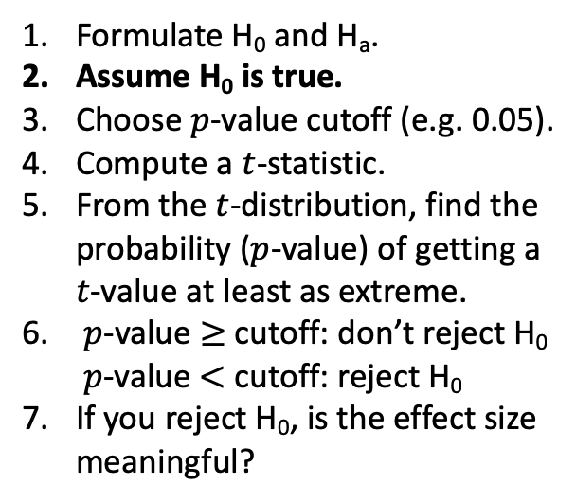
data set A
data set B
x
x
x
x
x
x
x
x
x
x
x
x
x
x
x
x
x
x
x
x
x
x
x
x
Compare means of two normally distributed data sets
x
x
x
x
x
x
x
x
x
x
x
x
x
x
x
x
x
x
x
x
$$t=\frac{{\overline{x}}_{A}−{\overline{x}}_{B}}{\sqrt{\frac{{s_{A}}^{2}}{n_{A}}+\frac{{s_{B}}^{2}}{n_{B}}}}$$
Formulate H₀ and H_{a}.
Assume H₀ is true.
Choose $p$-value cutoff (e.g. 0.05).
Compute a $t$-statistic.
From the $t$-distribution, find the probability ($p$-value) of getting a $t$-value at least as extreme.
$p$-value $≥$ cutoff: don’t reject H₀ $p$-value $<$ cutoff: reject H₀
If you reject H₀, is the effect size meaningful?
$t$-distribution assuming H₀ is true
H₀: $μ_{A}=μ_{B}$
H_{a}: $μ_{A}≠μ_{B}$
$p$-value (probability of finding ${\overline{x}}_{A}>{\overline{x}}_{B}$ by at least as much as observed if $μ_{A}=μ_{B}$)
$$−t$$
0
$$t$$
$p$-value (probability of finding ${\overline{x}}_{A}<{\overline{x}}_{B}$ by at least as much as observed if $μ_{A}=μ_{B}$)
Two-tailed $p$-value is the sum of the left- and right-tailed $p$-values (probability of finding the difference between ${\overline{x}}_{A}$ and ${\overline{x}}_{B}$ to be at least as much as observed if $μ_{A}=μ_{B}$)

Slide 46
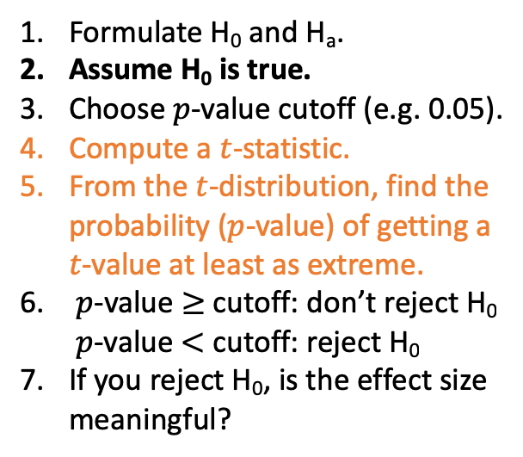
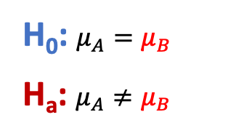
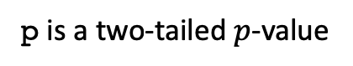
data set A
data set B
x
x
x
x
x
x
x
x
x
x
x
x
x
x
x
x
x
x
x
x
x
x
x
x
Compare means of two normally distributed data sets
x
x
x
x
x
x
x
x
x
x
x
x
x
x
x
x
x
x
x
x
Formulate H₀ and H_{a}.
Assume H₀ is true.
Choose $p$-value cutoff (e.g. 0.05).
Compute a $t$-statistic.
From the $t$-distribution, find the probability ($p$-value) of getting a $t$-value at least as extreme.
$p$-value $≥$ cutoff: don’t reject H₀ $p$-value $<$ cutoff: reject H₀
If you reject H₀, is the effect size meaningful?
independent data sets
t, p = scipy.stats.ttest_ind(dataA, dataB)
H₀: $μ_{A}=μ_{B}$
H_{a}: $μ_{A}≠μ_{B}$
p is a two-tailed $p$-value

Slide 47
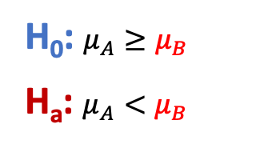
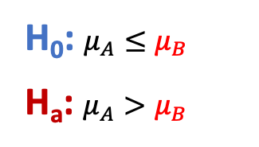
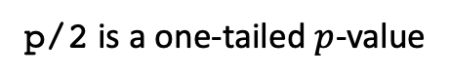
data set A
data set B
x
x
x
x
x
x
x
x
x
x
x
x
x
x
x
x
x
x
x
x
x
x
x
x
Compare means of two normally distributed data sets
x
x
x
x
x
x
x
x
x
x
x
x
x
x
x
x
x
x
x
x
Formulate H₀ and H_{a}.
Assume H₀ is true.
Choose $p$-value cutoff (e.g. 0.05).
Compute a $t$-statistic.
From the $t$-distribution, find the probability ($p$-value) of getting a $t$-value at least as extreme.
$p$-value $≥$ cutoff: don’t reject H₀ $p$-value $<$ cutoff: reject H₀
If you reject H₀, is the effect size meaningful?
independent data sets
t, p = scipy.stats.ttest_ind(dataA, dataB)
H₀: $μ_{A}=μ_{B}$
H_{a}: $μ_{A}≠μ_{B}$
p is a two-tailed $p$-value
H₀: $μ_{A}≤μ_{B}$
H_{a}: $μ_{A}>μ_{B}$
H₀: $μ_{A}≥μ_{B}$
H_{a}: $μ_{A}<μ_{B}$
p/2 is a one-tailed $p$-value

Slide 48
data set A
data set B
x
x
x
x
x
x
x
x
x
x
x
x
x
x
x
x
x
x
x
x
x
x
x
x
Compare means of two normally distributed data sets
x
x
x
x
x
x
x
x
x
x
x
x
x
x
x
x
x
x
x
x
Formulate H₀ and H_{a}.
Assume H₀ is true.
Choose $p$-value cutoff (e.g. 0.05).
Compute a $t$-statistic.
From the $t$-distribution, find the probability ($p$-value) of getting a $t$-value at least as extreme.
$p$-value $≥$ cutoff: don’t reject H₀ $p$-value $<$ cutoff: reject H₀
If you reject H₀, is the effect size meaningful?
paired data sets
dataA[i] ←→ dataB[i]
t, p = scipy.stats.ttest_rel(dataA, dataB)
H₀: $μ_{A}=μ_{B}$
H_{a}: $μ_{A}≠μ_{B}$
p is a two-tailed $p$-value
H₀: $μ_{A}≤μ_{B}$
H_{a}: $μ_{A}>μ_{B}$
H₀: $μ_{A}≥μ_{B}$
H_{a}: $μ_{A}<μ_{B}$
p/2 is a one-tailed $p$-value

Slide 49
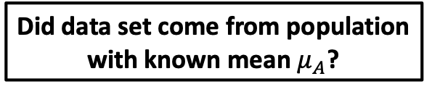
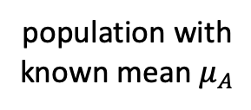
data set B
population with
known mean $μ_{A}$
x
x
x
x
x
x
x
x
x
x
x
Did data set come from population with known mean $μ_{A}$?
x
x
x
x
x
x
x
x
x
x
x
Formulate H₀ and H_{a}.
Assume H₀ is true.
Choose $p$-value cutoff (e.g. 0.05).
Compute a $t$-statistic.
From the $t$-distribution, find the probability ($p$-value) of getting a $t$-value at least as extreme.
$p$-value $≥$ cutoff: don’t reject H₀ $p$-value $<$ cutoff: reject H₀
If you reject H₀, is the effect size meaningful?
t, p = scipy.stats.ttest_1samp(dataB, $μ_{A}$)
H₀: $μ_{A}=μ_{B}$
H_{a}: $μ_{A}≠μ_{B}$
p is a two-tailed $p$-value
H₀: $μ_{A}≤μ_{B}$
H_{a}: $μ_{A}>μ_{B}$
H₀: $μ_{A}≥μ_{B}$
H_{a}: $μ_{A}<μ_{B}$
p/2 is a one-tailed $p$-value

Slide 50
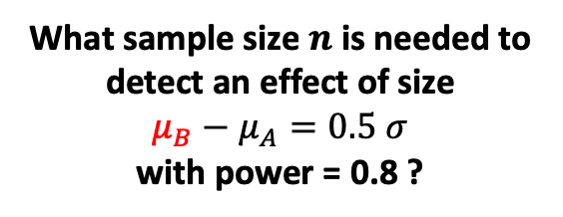
data set A
data set B
population A
mean $μ_{A}$
variance $σ^{2}$
population B
mean $μ_{B}$
variance $σ^{2}$
x
x
x
x
x
What sample size $n$ is needed to detect an effect of size
$μ_{B}−μ_{A}=0.5 σ$
with power = 0.8 ?
x
x
x
x
x
x
x
x
x
x
x
x
x
x
x
x
x
x
x
x
x
x
x
x
x
x
x
x
x
x
x
x
x
x
x
x
x
x
x

Slide 51
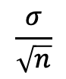
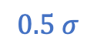
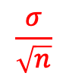
data set A
data set B
population A
mean $μ_{A}$
variance $σ^{2}$
population B
mean $μ_{B}$
variance $σ^{2}$
x
x
x
x
x
What sample size $n$ is needed to detect an effect of size
$μ_{B}−μ_{A}=0.5 σ$
with power = 0.8 ?
x
x
x
x
x
x
x
x
x
x
x
x
x
x
x
x
x
x
x
x
x
x
x
x
x
x
x
x
x
x
x
x
x
x
x
x
x
x
x
Central Limit Theorem
$$\frac{σ}{\sqrt{n}}$$
$$\frac{σ}{\sqrt{n}}$$
$${\overline{x}}_{A}$$
$${\overline{x}}_{B}$$
mean
$$μ_{A}$$
$$0.5 σ$$
$$μ_{B}$$

Slide 52
data set A
data set B
population A
mean $μ_{A}$
variance $σ^{2}$
population B
mean $μ_{B}$
variance $σ^{2}$
x
x
x
x
x
What sample size $n$ is needed to detect an effect of size
$μ_{B}−μ_{A}=0.5 σ$
with power = 0.8 ?
x
x
x
x
x
x
x
x
x
x
x
x
x
x
x
x
x
x
x
x
x
x
x
x
x
x
x
x
x
x
x
x
x
x
x
x
x
x
x
$$\frac{σ}{\sqrt{n}}$$
$$\frac{σ}{\sqrt{n}}$$
power
$${\overline{x}}_{A}$$
$${\overline{x}}_{B}$$
mean
$$μ_{A}$$
$$0.5 σ$$
$$μ_{B}$$

Slide 53
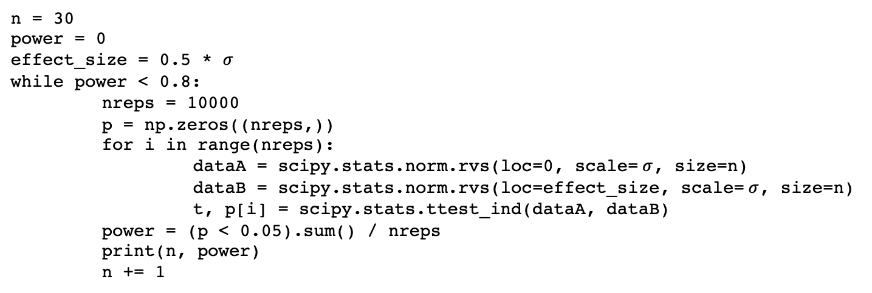
data set A
data set B
population A
mean $μ_{A}$
variance $σ^{2}$
population B
mean $μ_{B}$
variance $σ^{2}$
x
x
x
x
x
What sample size $n$ is needed to detect an effect of size
$μ_{B}−μ_{A}=0.5 σ$
with power = 0.8 ?
x
x
x
x
x
x
x
x
x
x
x
x
x
x
x
x
x
x
x
x
x
x
x
x
x
x
x
x
x
x
x
x
x
x
x
x
x
x
x
n = 30
power = 0
effect_size = 0.5 * $σ$
while power < 0.8:
nreps = 10000
p = np.zeros((nreps,))
for i in range(nreps):
dataA = scipy.stats.norm.rvs(loc=0, scale= $σ$, size=n)
dataB = scipy.stats.norm.rvs(loc=effect_size, scale= $σ$, size=n)
t, p[i] = scipy.stats.ttest_ind(dataA, dataB)
power = (p < 0.05).sum() / nreps
print(n, power)
n += 1

Slide 54
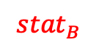

data set A
data set B
x
x
x
x
x
x
x
x
x
x
x
x
x
x
x
x
x
x
x
x
x
x
x
x
Compare some statistic of two data sets
x
x
x
x
x
x
x
x
x
x
x
x
x
x
x
x
x
x
x
x
$${stat}_{A}$$
$${stat}_{B}$$
statistic

Slide 55
data set A
data set B
x
x
x
x
x
x
x
x
x
x
x
x
x
x
x
x
x
x
x
x
x
x
x
x
Compare some statistic of two data sets
x
x
x
x
x
x
x
x
x
x
x
x
x
x
x
x
x
x
x
x
Bootstrap distributions for statistics of A and B.
$${stat}_{A}$$
$${stat}_{B}$$
statistic

Slide 56
data set A
data set B
x
x
x
x
x
x
x
x
x
x
x
x
x
x
x
x
x
x
x
x
x
x
x
x
Compare some statistic of two data sets
x
x
x
x
x
x
x
x
x
x
x
x
x
x
x
x
x
x
x
x
Bootstrap distributions for statistics of A and B.
power
$${stat}_{A}$$
$${stat}_{B}$$
statistic
confidence interval

Slide 57
Types of t-Tests:
Does a single sample come from a known population with mean value μ?
H₀: Sample comes from population with known mean μ.
H_{a}: Sample does NOT come from population with known mean μ.
Do two independent samples come from the same distribution?
H₀: Samples come from the same distribution.
H_{a}: Samples do NOT come from the same distribution.
Do two related samples come from the same distribution?
H₀: Samples come from the same distribution.
H_{a}: Samples do NOT come from the same distribution.

Slide 58
An outline for hypothesis testing

Slide 59
State the null and alternative hypotheses.
Select an appropriate test statistic and a cutoff (e.g. α = 0.05).
Determine the sample size required for a given power (e.g. 1 – β = 0.8). This may require some assumptions.
Collect the sample data and compute the chosen statistic for the sample.
Compute a p-value for the chosen statistic.
Decide whether or not to reject the null hypothesis.
If the null hypothesis is rejected, determine the effect size and decide whether it is important or not.

